Slide 1

Requirements for Quorum
1

Slide 2
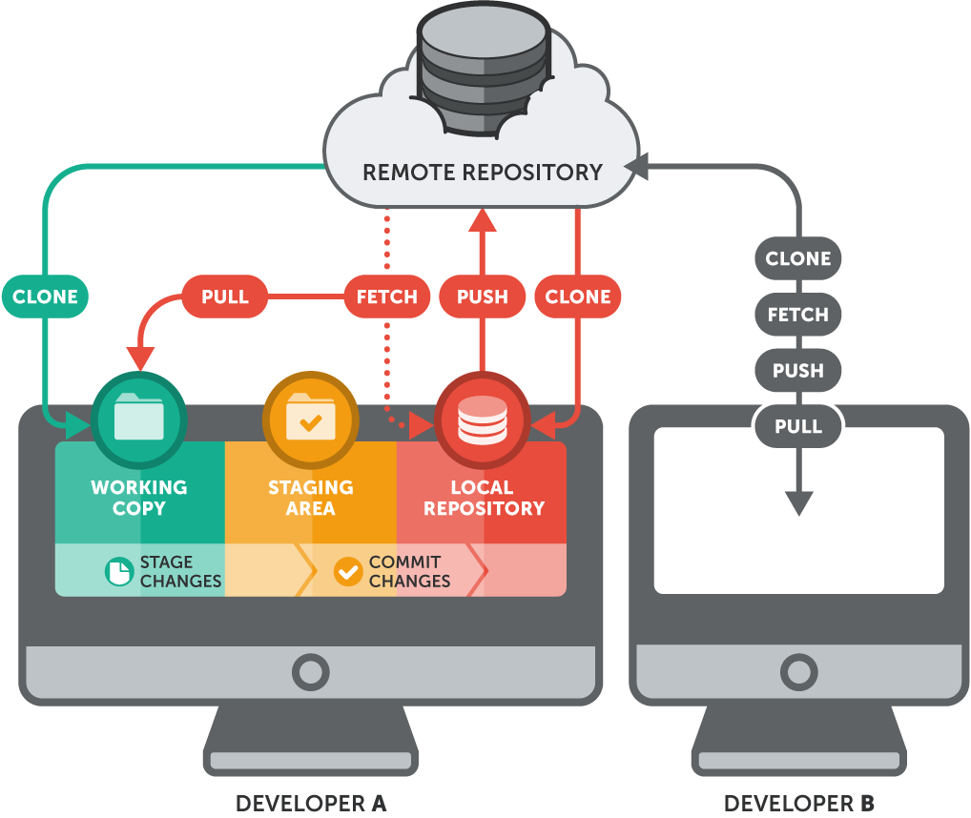
Repositories
We will be needing the following repositories:
Quorum Repo
Tessera Repo

Slide 3

Tools
Oracle JDK 8 JVM
Minimum supported version 8u171.
Downloaded from:
“http://www.oracle.com/technetwork/java/javase/downloads/jdk8-downloads-2133151.html”.
Open command prompt and run java –version command to check the installation.
Vagrant
Latest version of Vagrant is 2.2.4.
Downloaded from “https://www.vagrantup.com/downloads.html”.
Git
Required for windows developer only.
Downloaded from “https://git-scm.com/download/win”.
Open command prompt and run git -–version command to check the version.

Slide 4
Tools
VirtualBox
Downloaded from “https://www.virtualbox.org/wiki/Downloads”.
Latest version is 6.0.6.
Apache Maven
A management and comprehension tool.
Based on the theory of a project object model (POM).
Node.js
Downloaded from “https://nodejs.org/en”.
Latest version of node.js is 12.2.0.

Slide 5

Libraries
Libsodium
An shared library with machine-independent set of headers that can easily be used by 3rd
party projects.
Latest version is Version 1.0.17, that was released on January 7, 2019.
Jnacl
Pure Java implementation of the Networking and Cryptography library (NaCl).
Supports the “Curve25519xsalsa20poly1305” crypto primitives.
Kailum
A Java essential to Networking and Cryptography library.
Implemented using jnr-ffi to bind the shared libraries from libsodium.

Slide 6

Language
Solidity
An high-level object-oriented language for implementing smart contracts in Ethereum.
Features include statically typed, supporting inheritance, libraries and complex user-defined types.
It is influenced by C++, JavaScript, and Python.
Designed to target the Ethereum Virtual Machine (EVM).

Slide 7
THANK YOU!

